Slide 1
Treatment of Anxiety Disorders from a Contextual Behavioral Viewpoint
Michael P. Twohig, Ph.D.
Associate Professor of Psychology
Utah State University
Workshop at ACBS conference
Minneapolis June 17, 2014

Slide 2


Slide 3

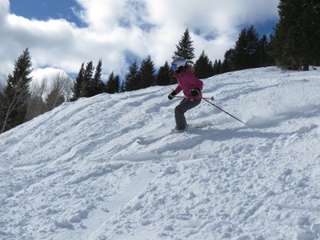
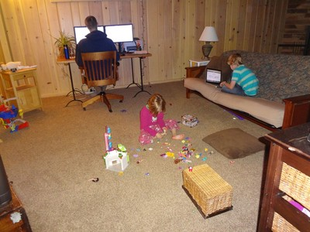
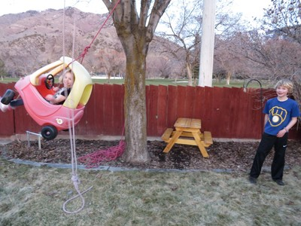
My life

Slide 4
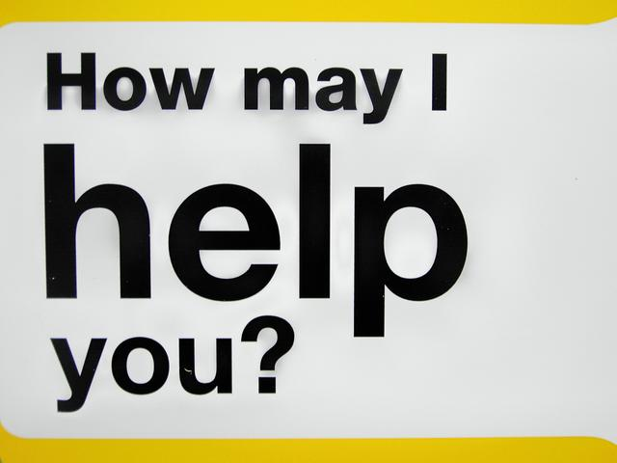
Certain populations?
Is this said A-C-T or “ACT”?
Age groups?
How does this fit with what I do?
Empirical support?
What is contextual behavioral science?
Is it ethical to use ACT?
What do you want to get out of today?
Is this really any different than CBT?
Do I need to know about RFT?
I saw Hayes present on this and he’s nuts.

Slide 5
Plan for the day
25% = Basic aspects
75% = Applied aspects
One favor
  Please ask questions

Slide 6
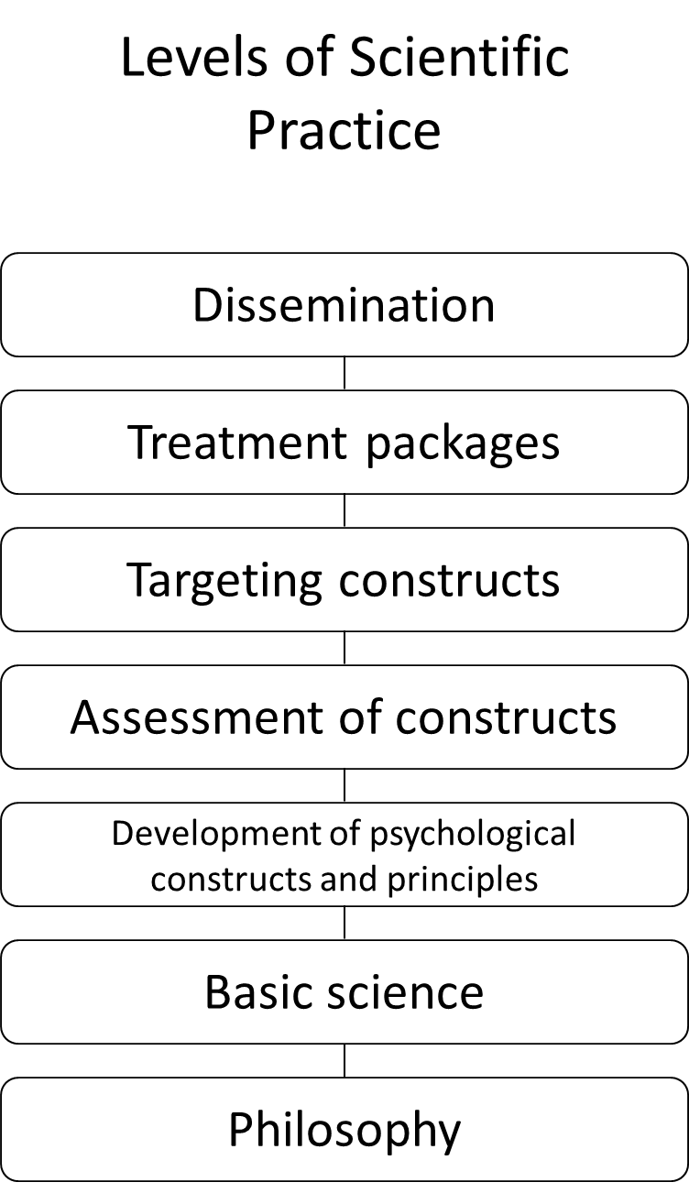

Slide 7
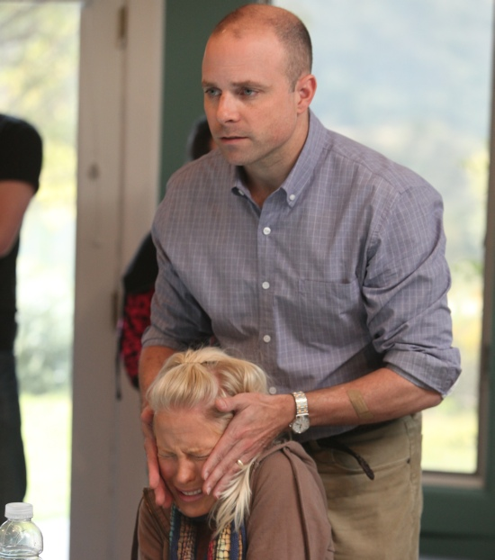
Exposure Therapy
Procedure (How you do it)?
Process of change (What type of learning do you hope is occurring)?
Outcome (How do you know you are helping the client)?

Slide 8
Example of the importance of basic sciences
Extinction involves new leaning and not unlearning
  spontaneous recovery (passage of time)
  disinhibition (presentation of a novel stimulus)
  reinstatement (presentation of the US or reinforcer)
  renewal (a change in context)
  resurgence (new behavior introduced during extinction places on extinction)

Slide 9
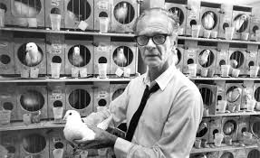
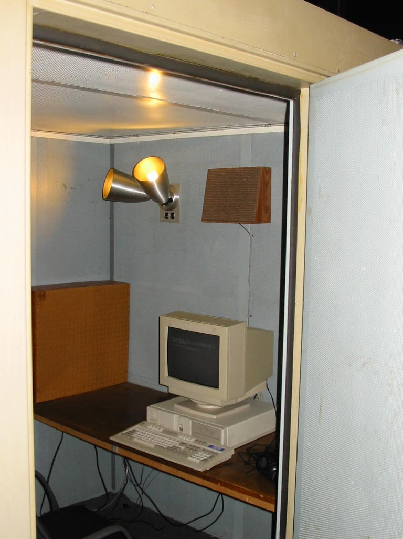
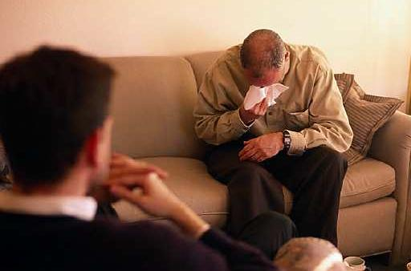
Important aspects of CBS
1
2
3

Slide 10
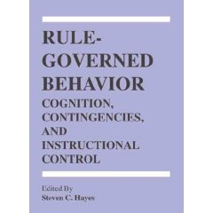
Rule Governed Behavior
Verbal humans are insensitive to
  environmental contingencies
Non-verbal ones are not
How does this happen?

Slide 11
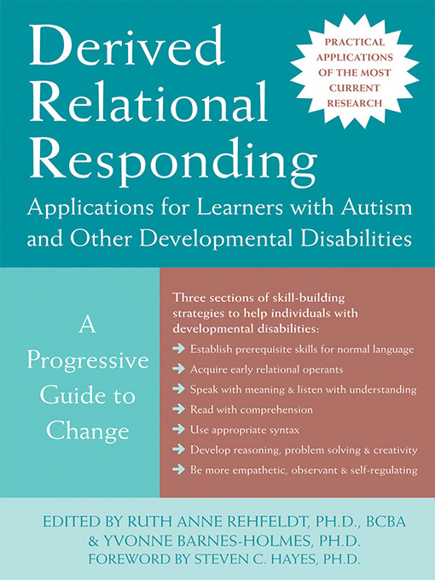


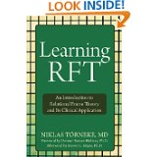


Relational Frame Theory
Stimuli
Three-term contingency
Meaning vs function

Slide 12

Language: The two-edged sword
Useful and interfering effects of this ability
Grocery store
My wife and our children, “getting older”
We can apply this to our own thinking and emotions

Slide 13
Experiential Avoidance
  Experiential avoidance is the tendency to attempt to alter the form, frequency, or situational sensitivity of historically produced negative private experience (emotions, thoughts, bodily sensations) even when attempts to do so cause psychological and behavioral harm

Slide 14
Psychological Inflexibility
  The ability to contact the present moment more fully as a conscious human being, and based on what the situation affords, to change or persist in behavior in order to serve valued ends

Slide 16
Anxiety disorders
Social phobia
Specific phobia
Posttraumatic Stress Disorder
Generalized anxiety Disorder
Obsessive compulsive disorder
  OC-spectrum disorders
Health Anxiety

Slide 17
AAQ and Anxiety
63 studies
  AAQ and all measures of anxiety r = .45
General anxiety symptoms r = .48
Specific anxiety disorder symptoms r = .42
Specific disorders
  GAD r = .61
  Social phobia r = .41
  PTSD r = .39
  OCD r = .36
  panic/agoraphobia r = .21
Bluett et al. (in press). JAD

Slide 18
ACT Targets Psychological Inflexibility
ACT targets the verbal context in which cognition occur
  Decreases literality
Behavior change occurs is in the service of values
Therapy is about helping people live meaningful, exciting lives
If these processes are core to pathology, targeting them should result in positive outcomes

Slide 19
Effect size by component relative to inactive conditions
Large effect
Medium effect
  Levin et al., 2012 Behavior Therapy
Notes:
Explain why not impacting psych distress
The meta-analysis included 66 lab-based studies testing interventions that were found to target psych flex components. We found broad support for the PF model including that brief interventions targeting these processes had greater impact on lab-based measures relative to inert control conditions as well as conditions emphasizing experiential avoidance strategies or cognitive fusion strategies. There were larger effect sizes when looking at outcomes we would most likely expect to be affected such as behavioral persistence, believability of thoughts, and willingness to experience difficult thoughts and feelings, while the effects on psychological distress were small or nonexistent depending on the comparison. We also found, consistent with theory, that just telling participants to accept or be mindful was relatively inert, and that its important to include experiential or metaphor-based strategies.

Slide 20
Anxiety outcome research
Randomized Trials
Effectiveness=4
Mixed Anxiety=2
GAD=2
PTSD=
Social Phobia=0
Panic Disorder=0
Specific Phobia=2
OCD=2
OC-Spectrum=2
SS designs, cases, open
Mixed Anxiety=2
GAD=1
PTSD=4
Social Phobia=7
Panic Disorder=2
Specific Phobia=0
OCD=6
OC-Spectrum=6

Slide 21
Some misconceptions about exposure work
Within and between session fear reduction is associated with better clinical outcomes
Moving through the hierarchy in an orderly fashion is best
Can’t stop exposures without fear reduction
Exposure is about fear reduction
  Not fear toleration
“optimizing learning …. based on increasing tolerance for fear and anxiety” (Arch & Craske, 2009)

Slide 22
ACT’s view on Exposure
Procedure
  Contacting feared stimuli
  And/or engaging in valued activities
  While practicing ACT concepts
Process of change
  Psychological flexibility
Desired outcome
  Greater life functioning
  Change in internal experience not a concern

Slide 23
C
B
T
Motivational Interviewing
Many others
Mindfulness Based Cognitive Therapy
Functional Analytic Psychotherapy
Exposure with response prevention
Wilhelm and Steketee’s Cognitive Therapy for OCD
Beck’s Cognitive Therapy
Appraisal work
Metacognitive Therapy
Dialectical Behavior Therapy
Barlow’s Unified Protocol
Schema Therapy
Mindfulness Based Stress Reduction
Acceptance and Commitment Therapy
Rational Emotive Behavior Therapy

Slide 24
The Primary ACT Model of Treatment
Psychological
Flexibility

Slide 25
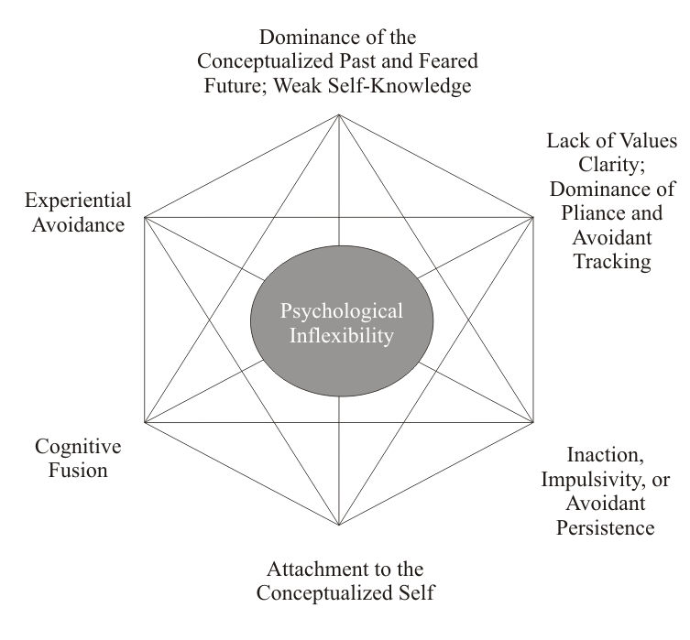
The Primary ACT Model of Psychopathology

Slide 26
Outcomes
Quality of life vs symptom reduction
Problem with “typical” outcome measures
Behavior tracking
May initially confuse clients

Slide 27
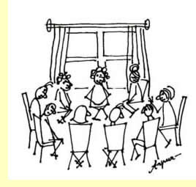
How this is presented to clients
Different
Roller coaster
Judge at end
Outcome
Notes:
Either use Facing the Struggle Video or I can demonstrate how I usually do it

Slide 28
ACT specifics
Client and therapist are on equal ground
Shy away from being literal
    No models
Confusing and paradoxical talk
Exercises
  Not explaining why
Workability trumps accuracy

Slide 29
Act for anxiety
Ok with anxiety
Focus on quality of life
See thoughts for what they are
Person experiencing the anxiety
Being present
Practicing following values

